Slide 1
Simulation based inference and Variance sum rule

Slide 2
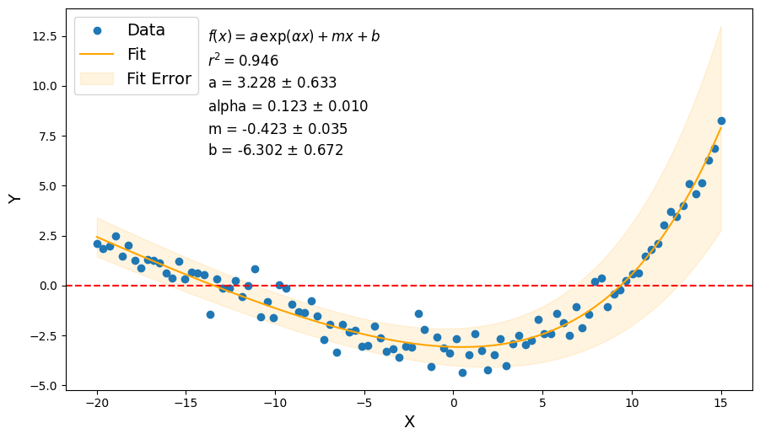
Finding optimal model parameters given a set of data
Fit

Slide 3
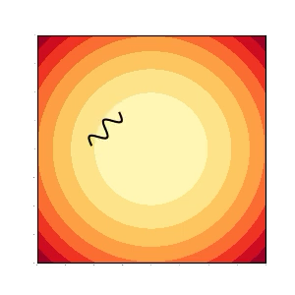
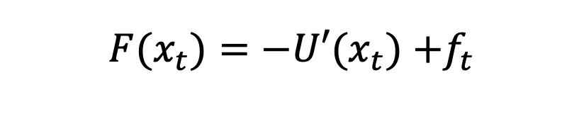

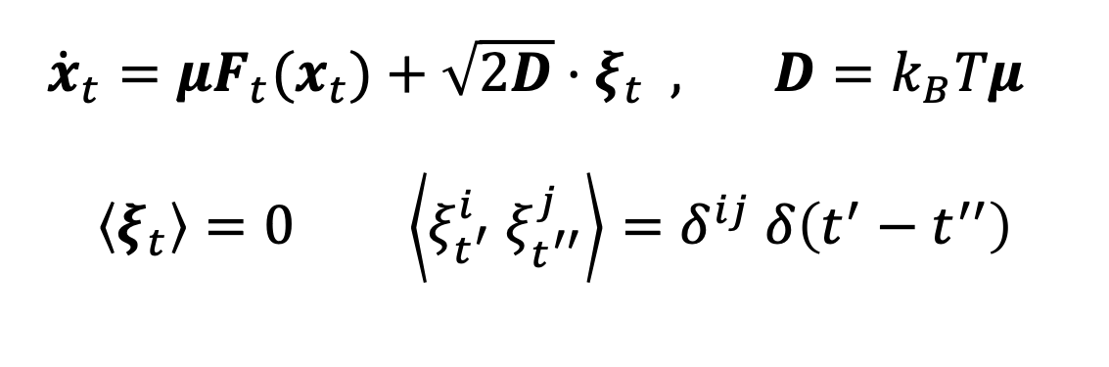
Stochastic systems
Framework
${F(x}_{t})=−{U′(x}_{t})$ $+f_{t}$
$${U(x}_{t})=κx_{t}^{2}/2$$
${\dot{x}}_{t}={μF_{t}(x}_{t})+\sqrt{2D}⋅ξ_{t} , D=k_{B}Tμ$
$$\left\langle ξ_{t}\right\rangle =0 \left\langle ξ_{t^{′}}^{i} ξ_{t^{′′}}^{j}\right\rangle =δ^{ij} δ\left(t^{′}−t^{′′}\right)$$

Slide 4
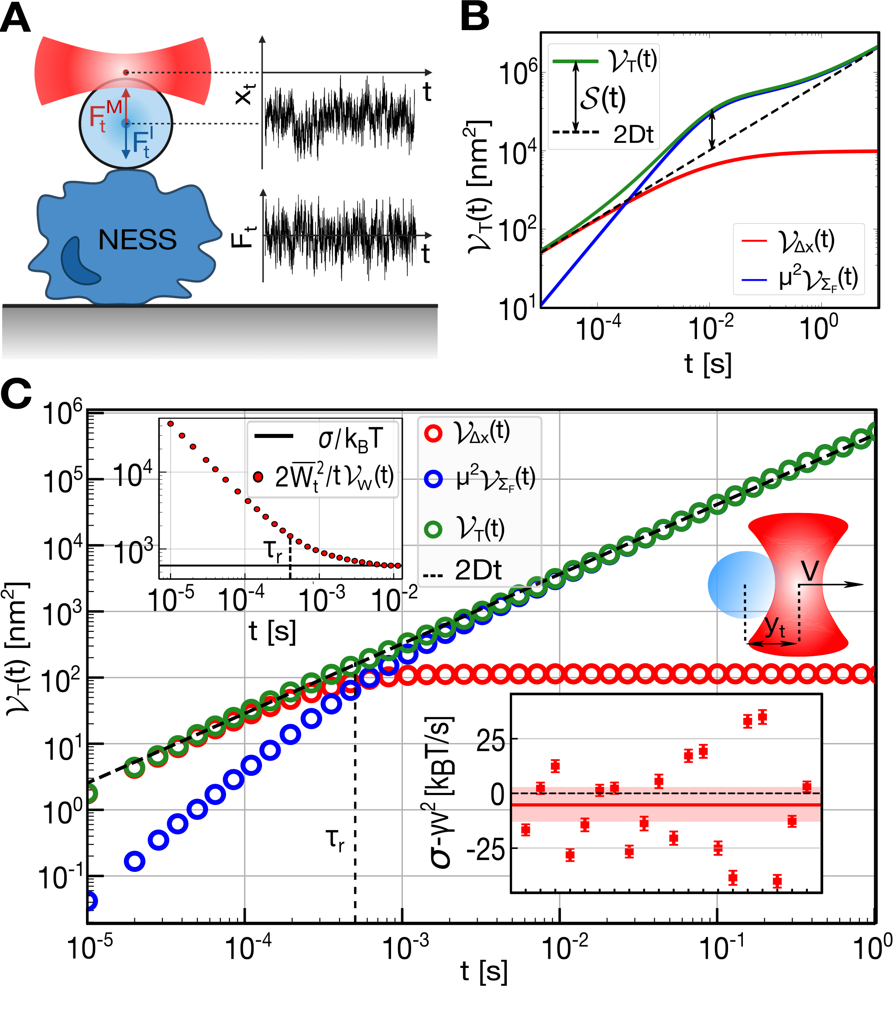
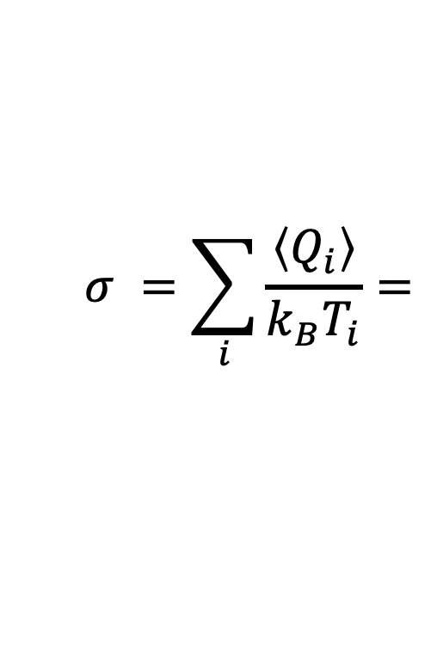
Estimate thermodynamic quantities
Aim
$$σ =\sum_{i}{\frac{\left\langle Q_{i}\right\rangle }{k_{B}T_{i}}=}$$
$${=k}_{B}^{−1}\left\langle {\left(T^{−1}⋅F_{t}\right)}^{T}∘{\dot{x}}_{t}\right\rangle$$

Slide 5
Estimate thermodynamic quantities
Aim
$$σ =\sum_{i}{\frac{\left\langle Q_{i}\right\rangle }{k_{B}T_{i}}=}$$
Non-
equilibrium
$${=k}_{B}^{−1}\left\langle {\left(T^{−1}⋅F_{t}\right)}^{T}∘{\dot{x}}_{t}\right\rangle$$

Slide 6

Estimate thermodynamic quantities
Aim
$$σ =\sum_{i}{\frac{\left\langle Q_{i}\right\rangle }{k_{B}T_{i}}=}$$
Non-
equilibrium
What can you fit?
$${=k}_{B}^{−1}\left\langle {\left(T^{−1}⋅F_{t}\right)}^{T}∘{\dot{x}}_{t}\right\rangle$$

Slide 7
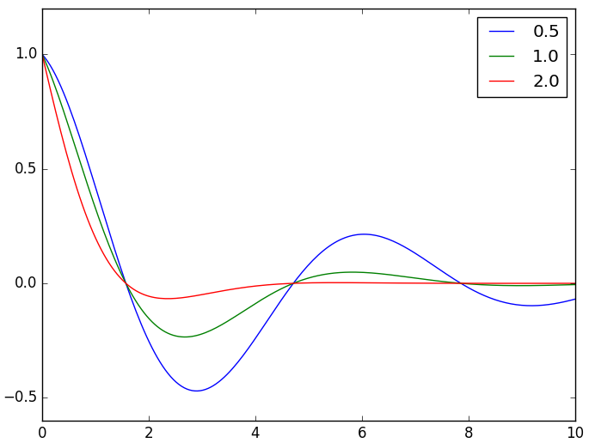

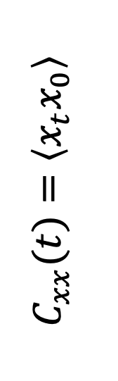
Calculate correlation functions...
$$C_{xx}(t)=\left\langle x_{t}x_{0}\right\rangle$$
$$t$$
… and fit them.

Slide 8
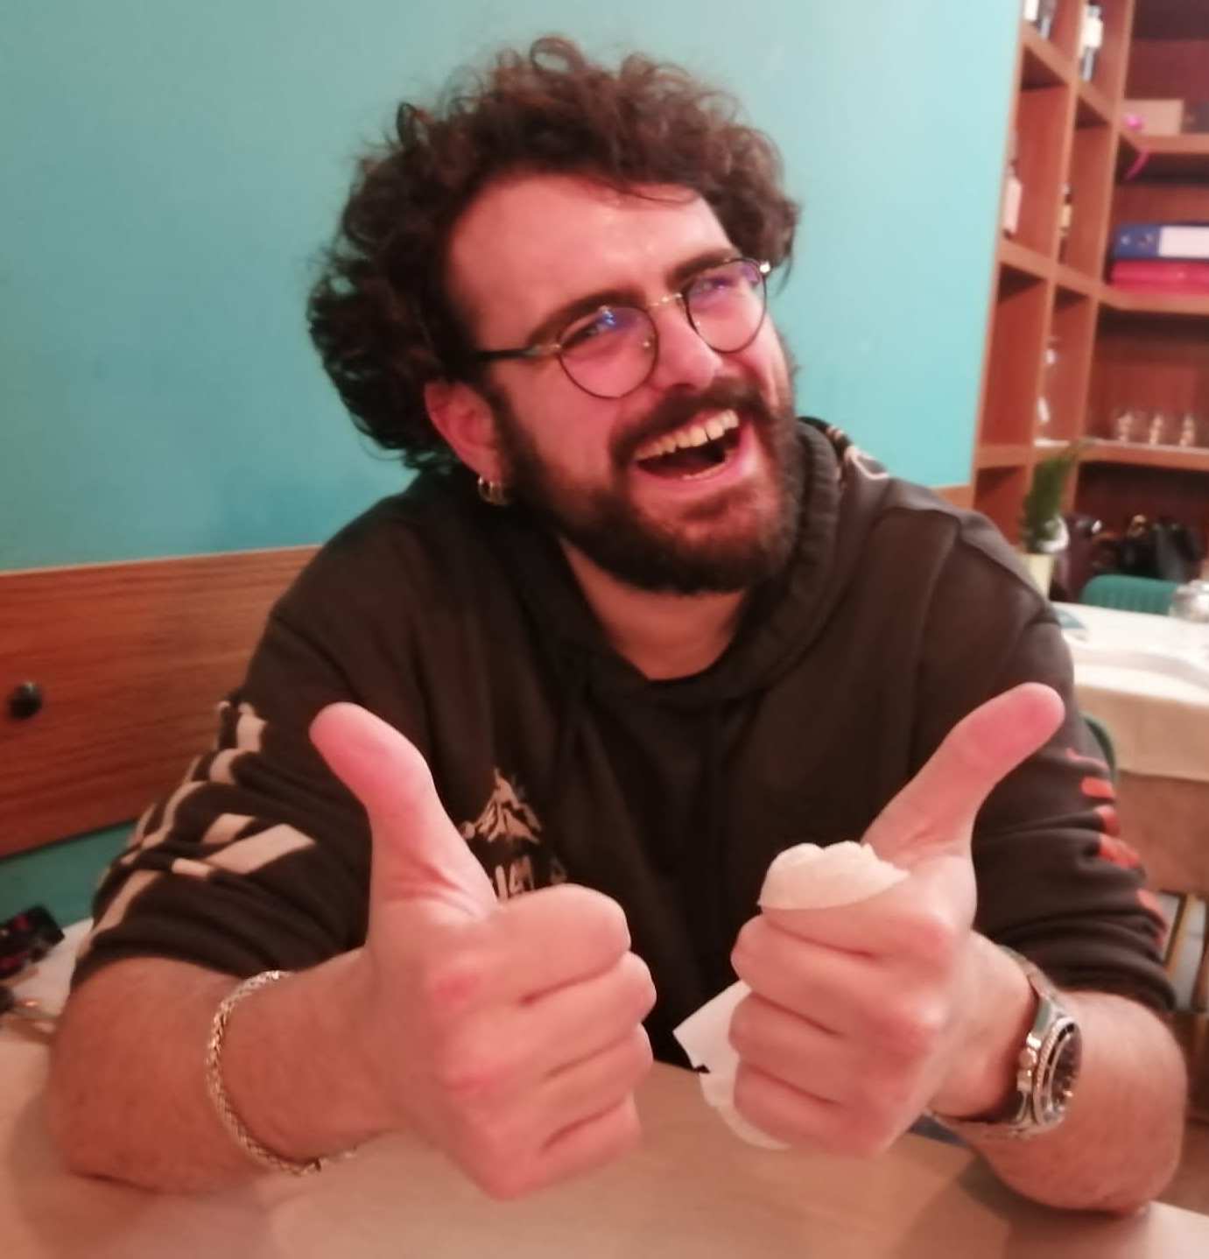
Model + parameters

Slide 9
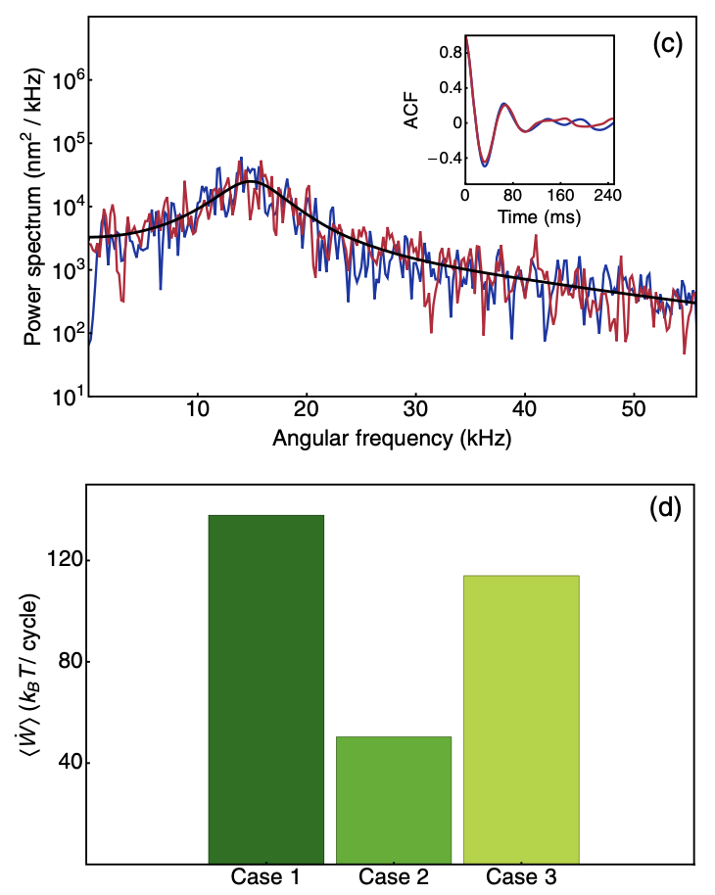
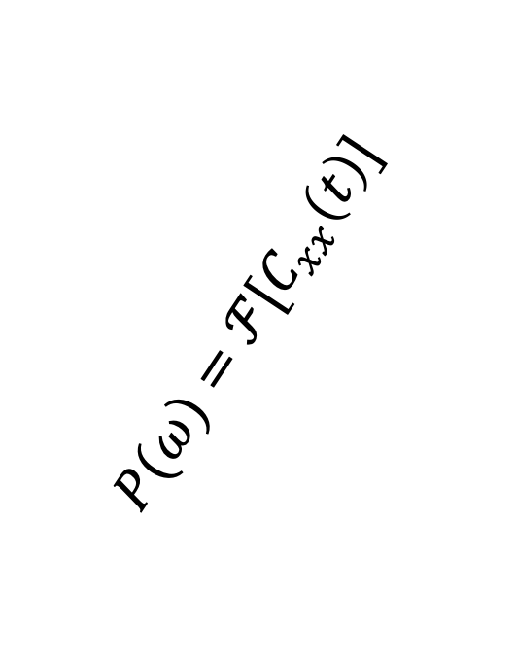
Model + parameters
$$P(ω)=ℱ[C_{xx}\left(t\right)]$$

Slide 10
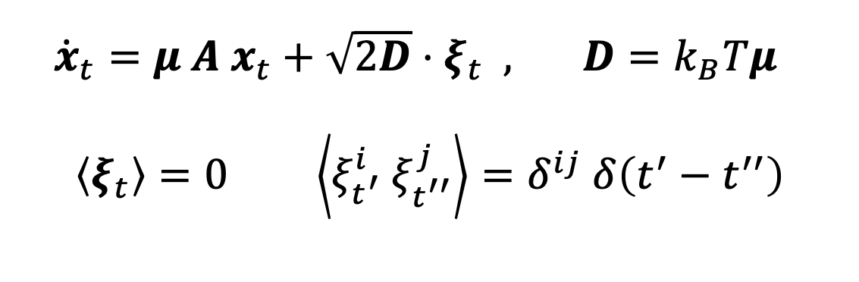
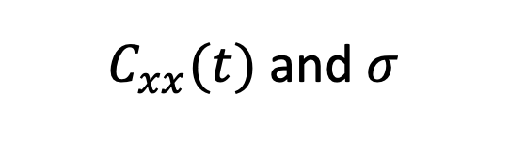
Analytical
Linear systems: simple (relatively)
${\dot{x}}_{t}={μ A x}_{t}+\sqrt{2D}⋅ξ_{t} , D=k_{B}Tμ$
$$\left\langle ξ_{t}\right\rangle =0 \left\langle ξ_{t^{′}}^{i} ξ_{t^{′′}}^{j}\right\rangle =δ^{ij} δ\left(t^{′}−t^{′′}\right)$$
$C_{xx}(t)$ and $σ$

Slide 11
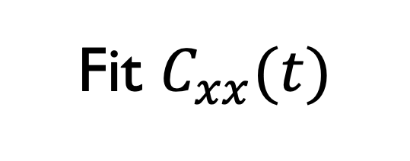
Analytical
Linear systems: simple (relatively)
${\dot{x}}_{t}={μ A x}_{t}+\sqrt{2D}⋅ξ_{t} , D=k_{B}Tμ$
$$\left\langle ξ_{t}\right\rangle =0 \left\langle ξ_{t^{′}}^{i} ξ_{t^{′′}}^{j}\right\rangle =δ^{ij} δ\left(t^{′}−t^{′′}\right)$$
$C_{xx}(t)$ and $σ$
Fit $C_{xx}(t)$

Slide 12
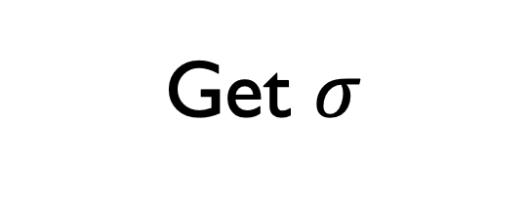
Analytical
Linear systems: simple (relatively)
${\dot{x}}_{t}={μ A x}_{t}+\sqrt{2D}⋅ξ_{t} , D=k_{B}Tμ$
$$\left\langle ξ_{t}\right\rangle =0 \left\langle ξ_{t^{′}}^{i} ξ_{t^{′′}}^{j}\right\rangle =δ^{ij} δ\left(t^{′}−t^{′′}\right)$$
$C_{xx}(t)$ and $σ$
Fit $C_{xx}(t)$
Get $σ$

Slide 13
Analytical
Linear systems: simple (relatively)
${\dot{x}}_{t}={μ A x}_{t}+\sqrt{2D}⋅ξ_{t} , D=k_{B}Tμ$
$$\left\langle ξ_{t}\right\rangle =0 \left\langle ξ_{t^{′}}^{i} ξ_{t^{′′}}^{j}\right\rangle =δ^{ij} δ\left(t^{′}−t^{′′}\right)$$
$C_{xx}(t)$ and $σ$
Fit $C_{xx}(t)$
Get $σ$

Slide 14
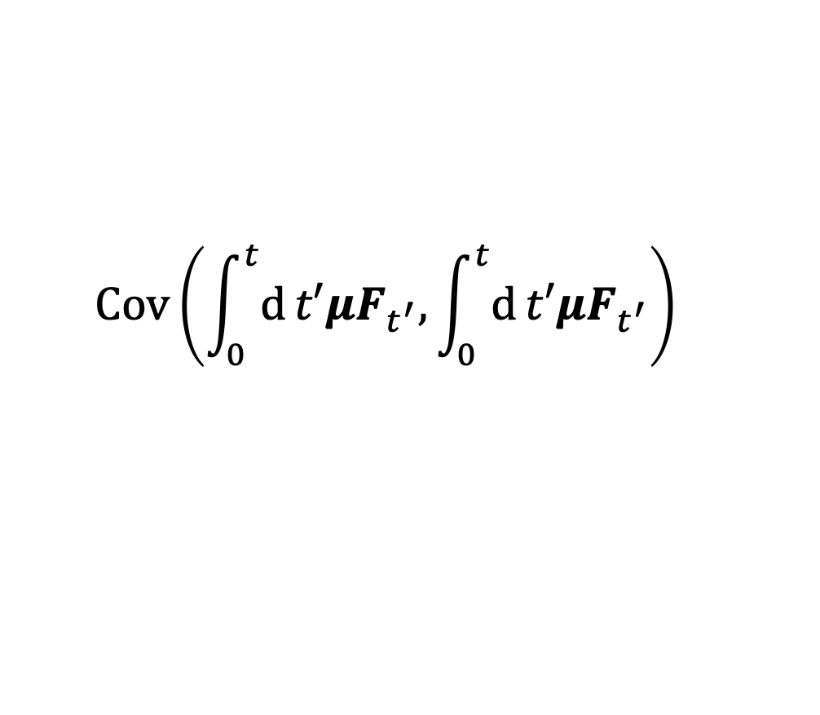
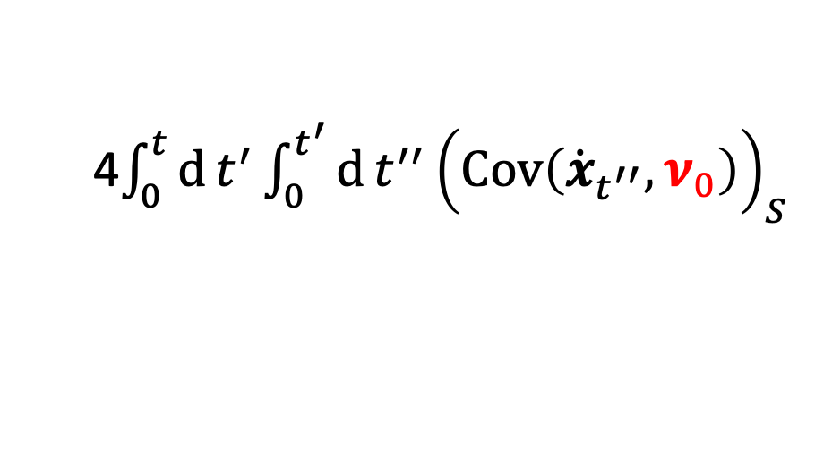
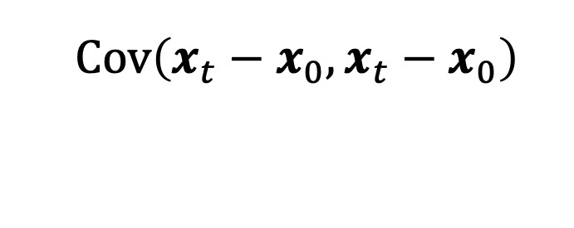
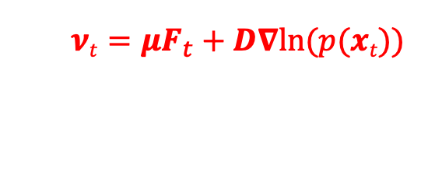
Variance sum rule (VSR)
$$𝒱_{Δx}\left(t\right)+𝒱_{ΣμF}\left(t\right)=2Dt+𝓢(t)$$
$$Cov\left(x_{t}−x_{0},x_{t}−x_{0}\right)$$
Excess variance:
4$\int_{0}^{t}{d}t^{′}\int_{0}^{t^{′}}{d}t^{′′ }{\left(Cov\left({\dot{x}}_{t^{′′}},ν_{0}\right)\right)}_{S}$
$$Cov\left(\int_{0}^{t}{d}t′μF_{t^{′}},\int_{0}^{t}{d}t′μF_{t^{′}}\right)$$
$$νt=μF_{t}+D∇ln⁡(p(xt))$$
Variance Sum Rule for Entropy
Production, I. Di Terlizzi et al.
2024 Science 383 971

Slide 15
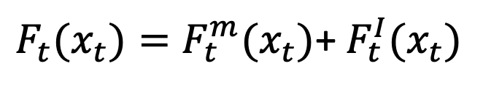
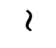
Reduced Variance sum rule (rVSR)
Data
$F_{t}(x_{t})=F_{t}^{m}(x_{t})$+ $F_{t}^{I}(x_{t})$
Model
$${\tilde{𝒱}}_{T}\left(t\right)=𝒱_{Δx}\left(t\right)+𝒱_{ΣμF^{m}}\left(t\right)=2Dt+ \tilde{𝒮}(t)$$
$$\sim$$

Slide 16
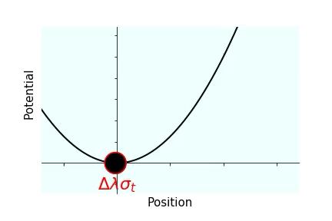
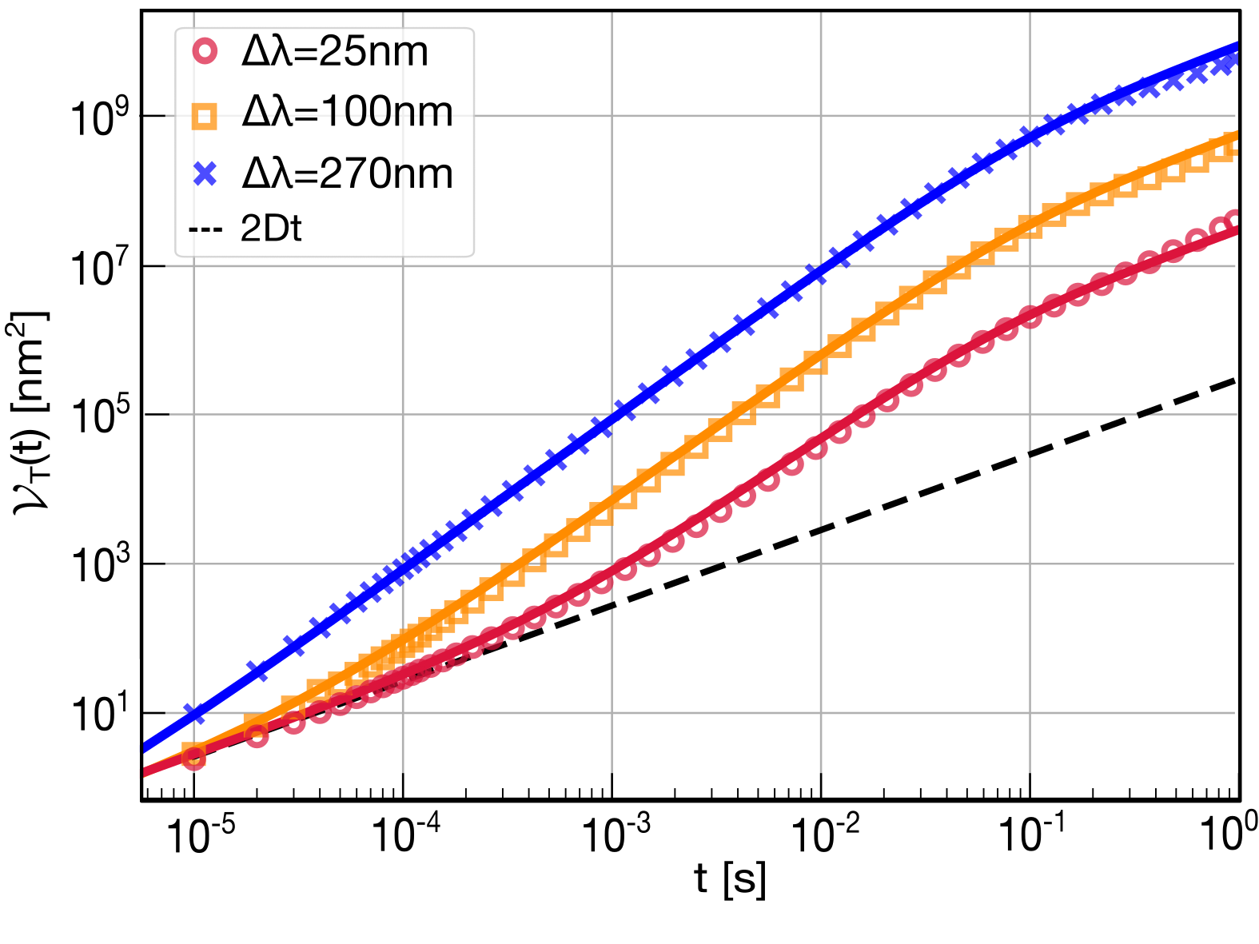
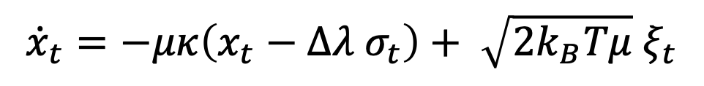
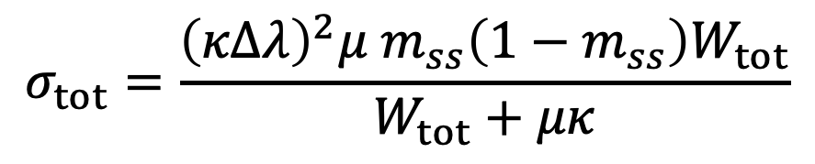
Reduced Variance sum rule (rVSR)
Data
$F_{t}(x_{t})=F_{t}^{m}(x_{t})$+ $F_{t}^{I}(x_{t})$
Model
$${\tilde{𝒱}}_{T}\left(t\right)=𝒱_{Δx}\left(t\right)+𝒱_{ΣμF^{m}}\left(t\right)=2Dt+ \tilde{𝒮}(t)$$
$${\dot{x}}_{t}=−μκ\left(x_{t}−Δλ{ σ}_{t}\right)+ \sqrt{2k_{B}Tμ} ξ_{t}$$
$$σ_{tot}=\frac{{\left(κΔλ\right)}^{2}μ m_{ss}\left(1−m_{ss}\right)W_{tot}}{W_{tot}+μκ}$$
$$\sim$$

Slide 17
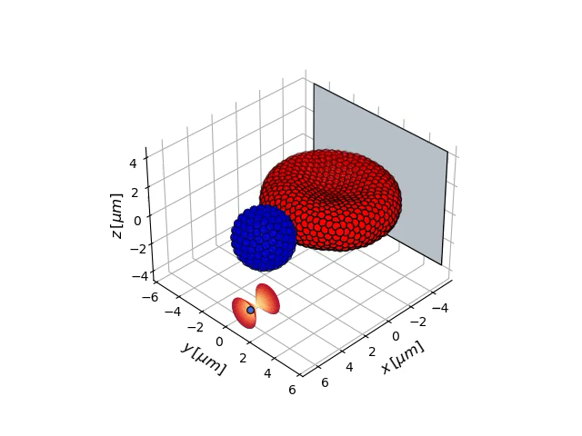
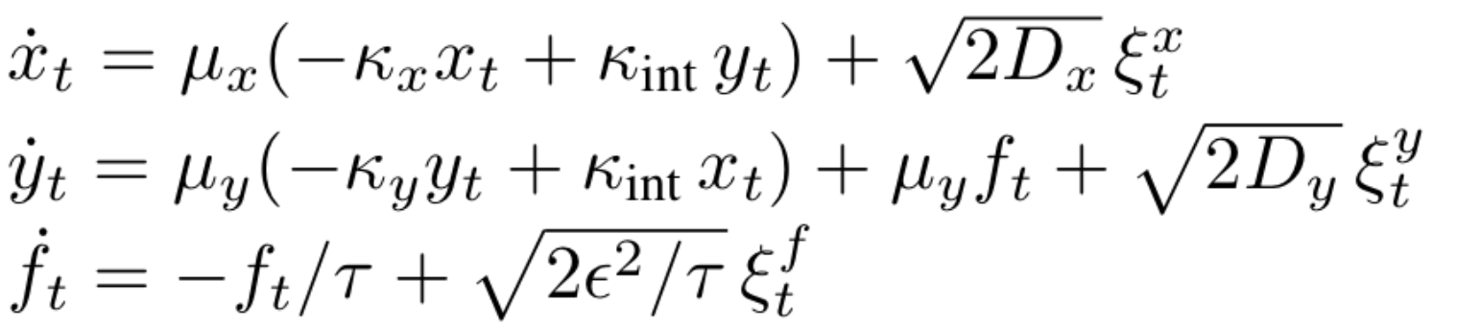
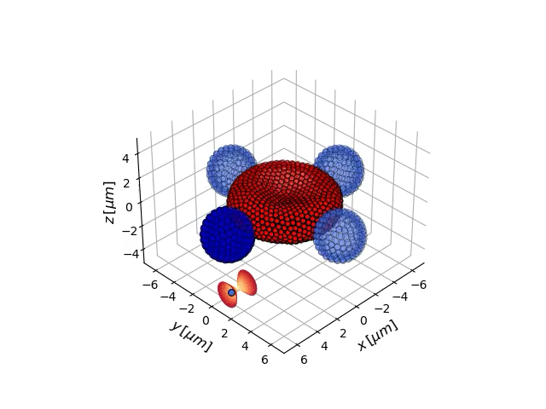
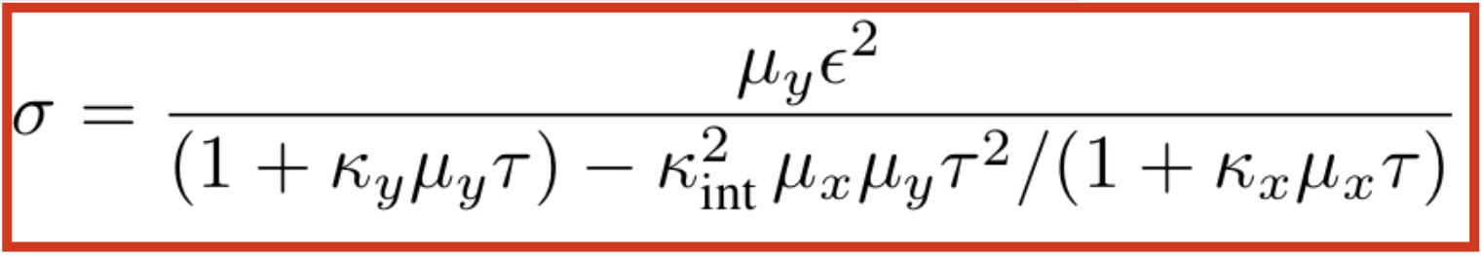
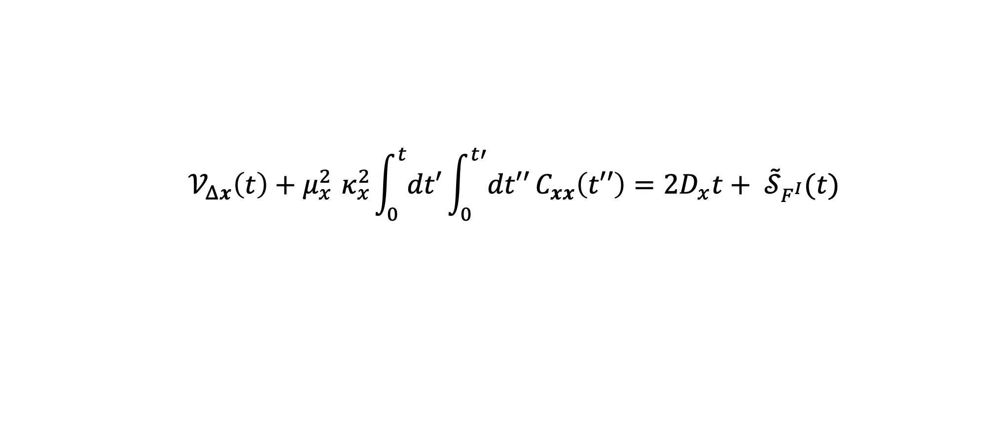
Model for Red Blood Cells
$$F^{I}$$
$$𝒱_{Δx}\left(t\right)+μ_{x}^{2}{ κ}_{x}^{2}\int_{0}^{t}{dt′}\int_{0}^{t′}{dt′′}C_{xx}\left(t′′\right)=2D_{x}t+ {\tilde{𝒮}}_{F^{I}}(t)$$
${\tilde{𝒮}}_{F^{I}}\left(t\right)=$Complicated…

Slide 18
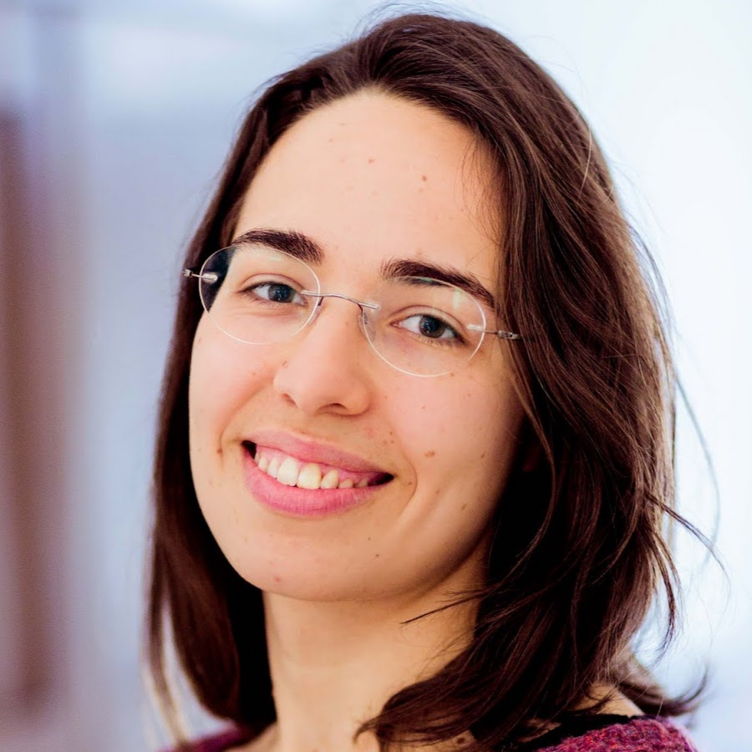
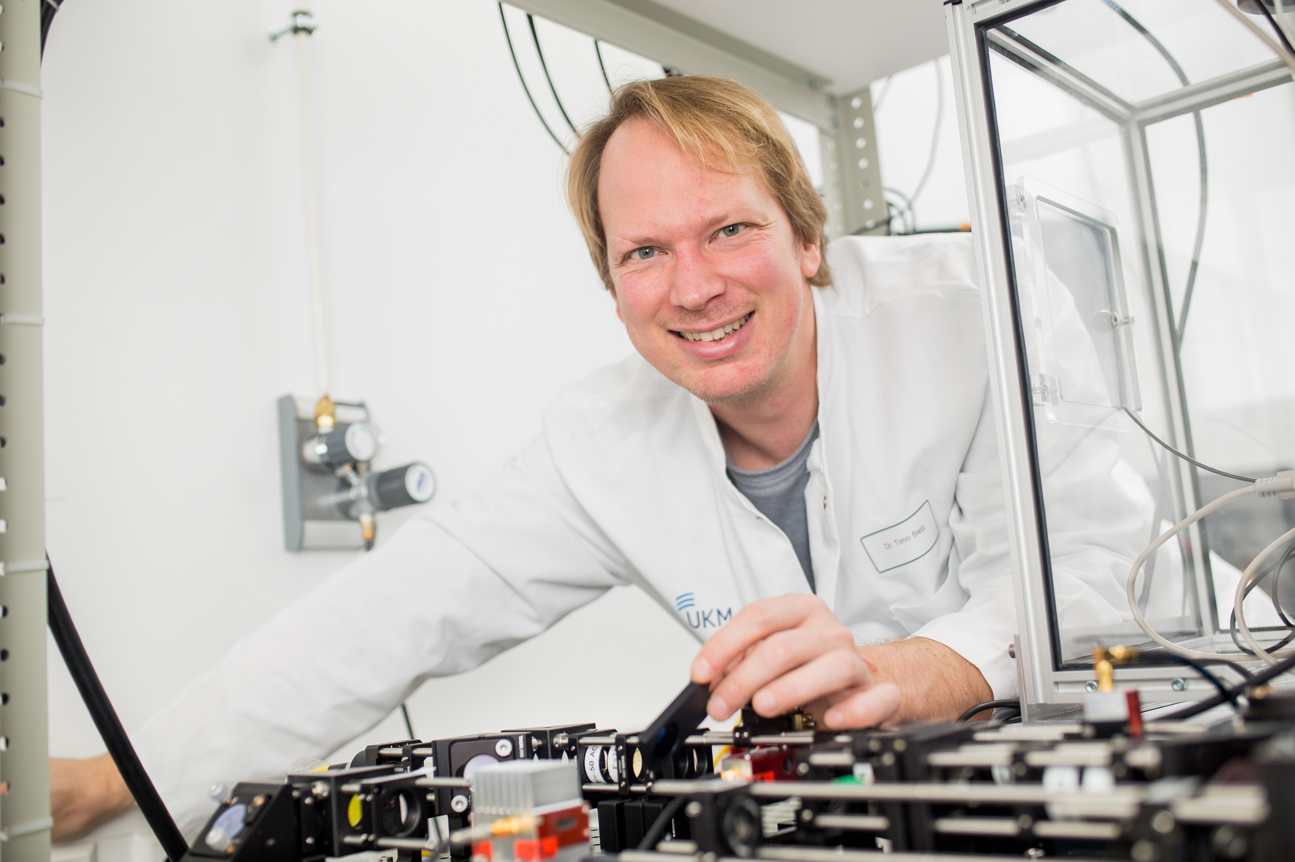
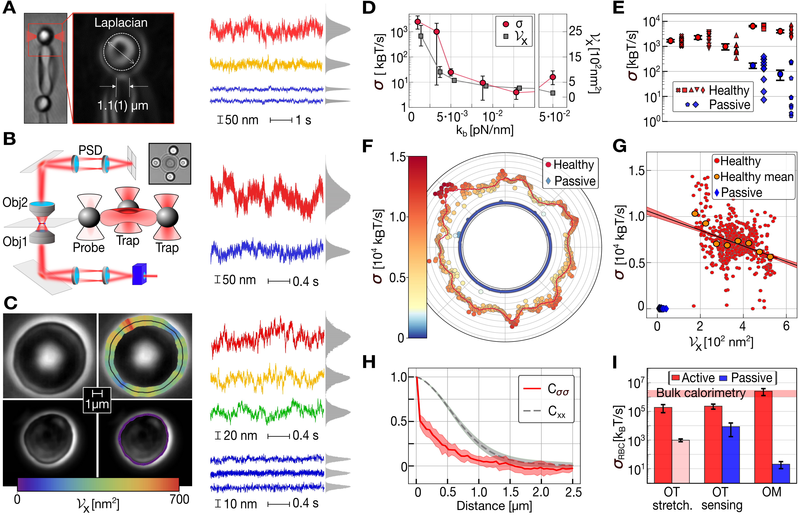
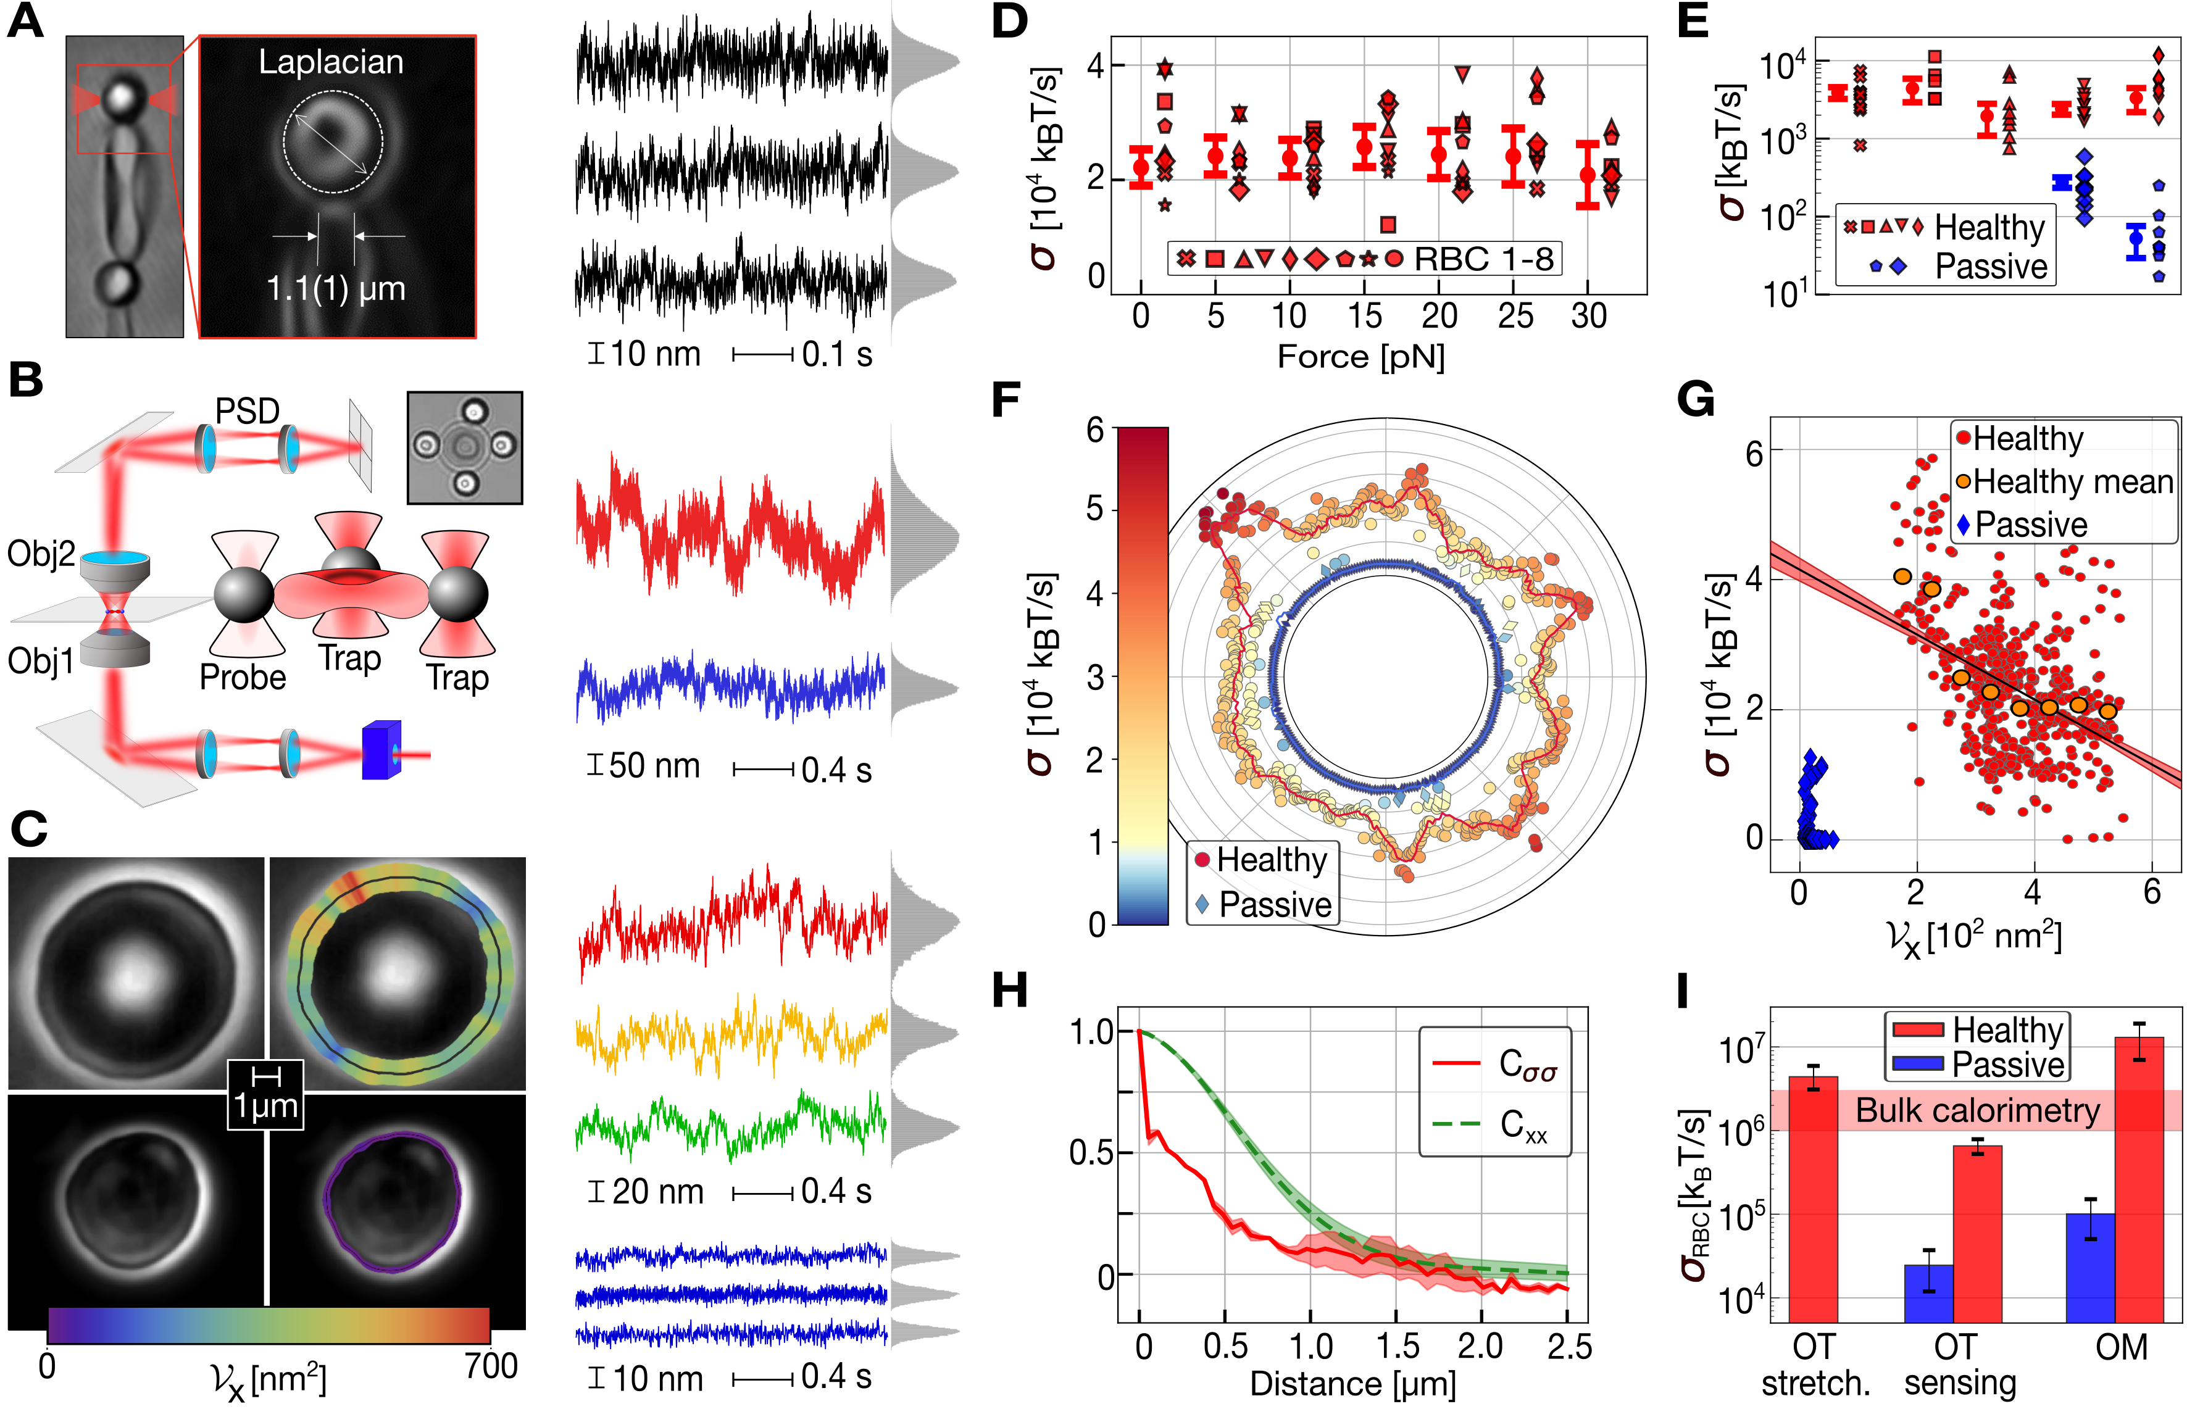

Experiments with optical tweezers
M. Gironella
T.Betz
Active
Passive

Slide 19
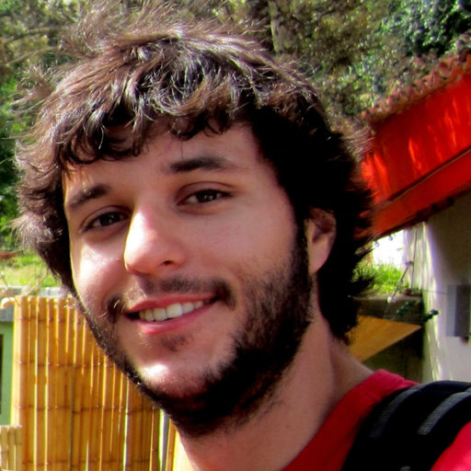
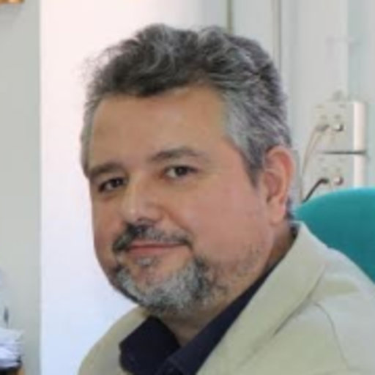
Experiments with ultrafast optical microscopy
D. Herráez-Aguilar
F. Monroy

Slide 20
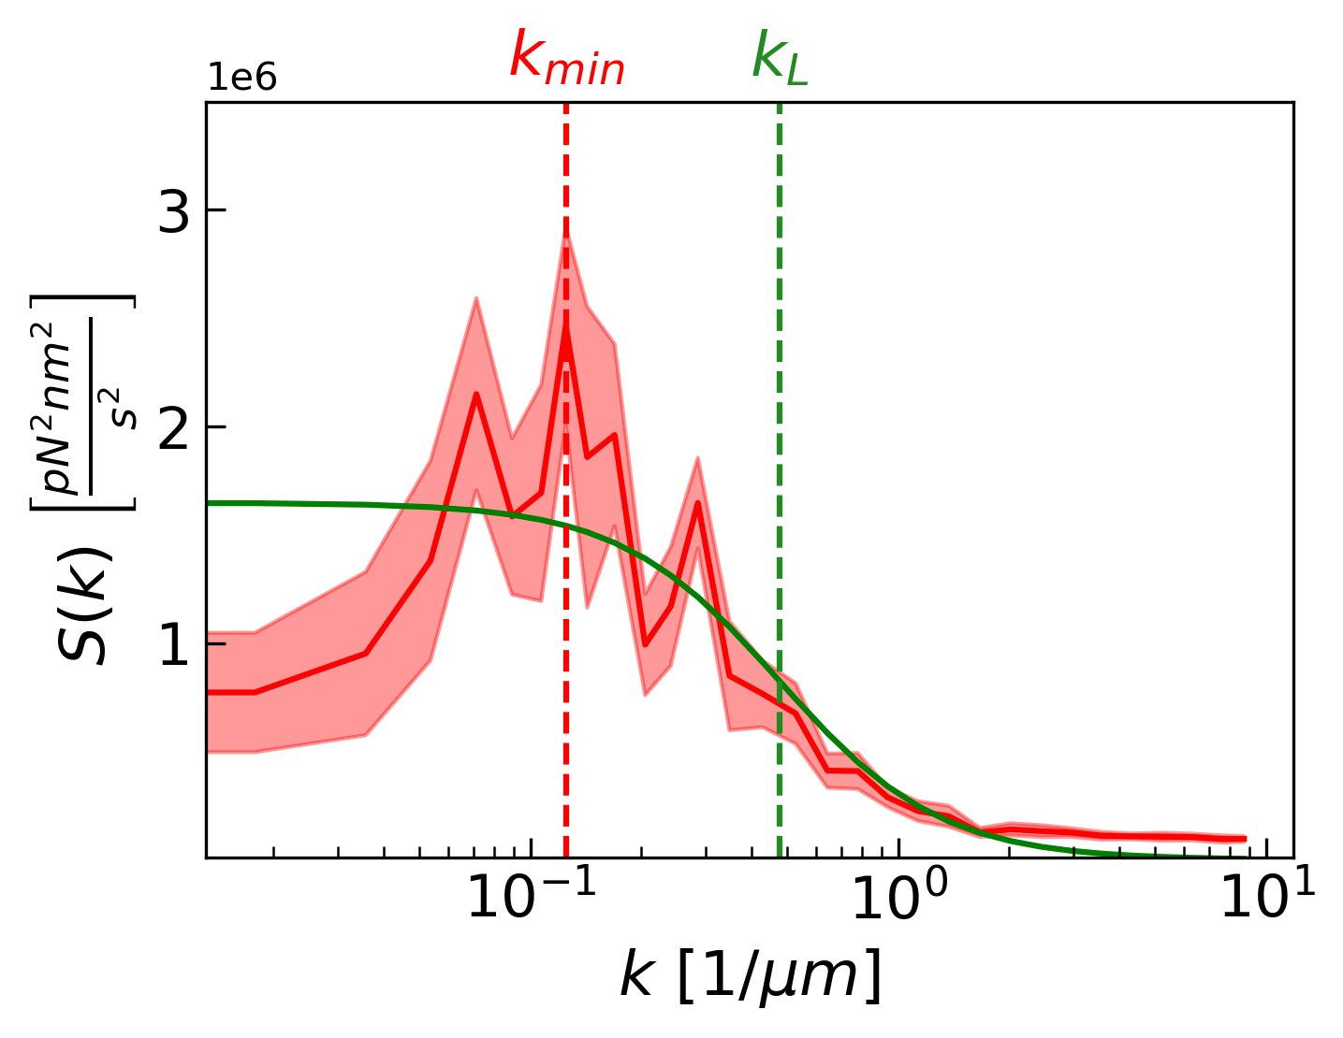
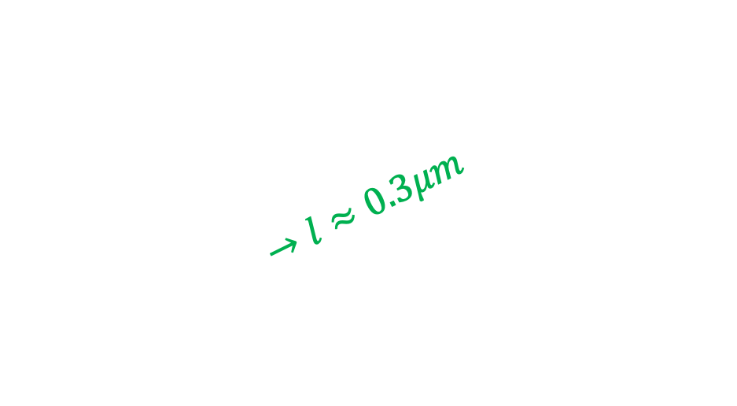
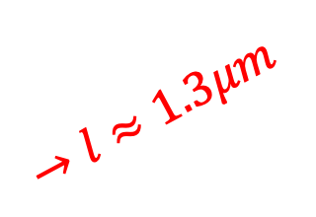
Experiments with ultrafast optical microscopy
$$→l≈0.3μm$$
$$→l≈1.3μm$$

Slide 21
What if the model is non linear?

Slide 22
What if the model is non linear?
S
B
I
imulation
ased
nference

Slide 23
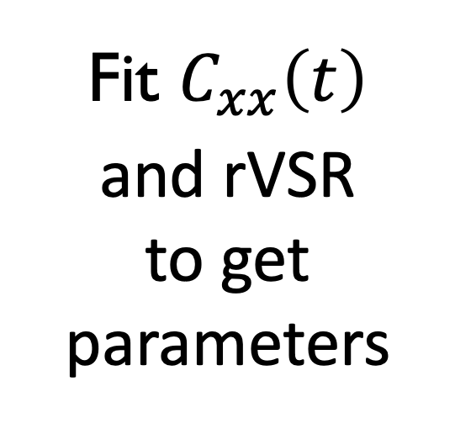
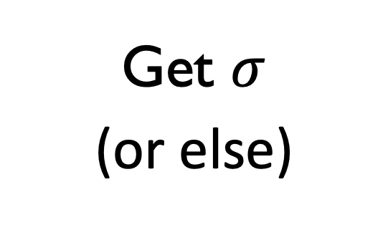
Fit $C_{xx}\left(t\right)$
and rVSR
to get parameters
Non-linear
model
Get $σ$
(or else)
SBI
Simulate model with fit parameters

Slide 24
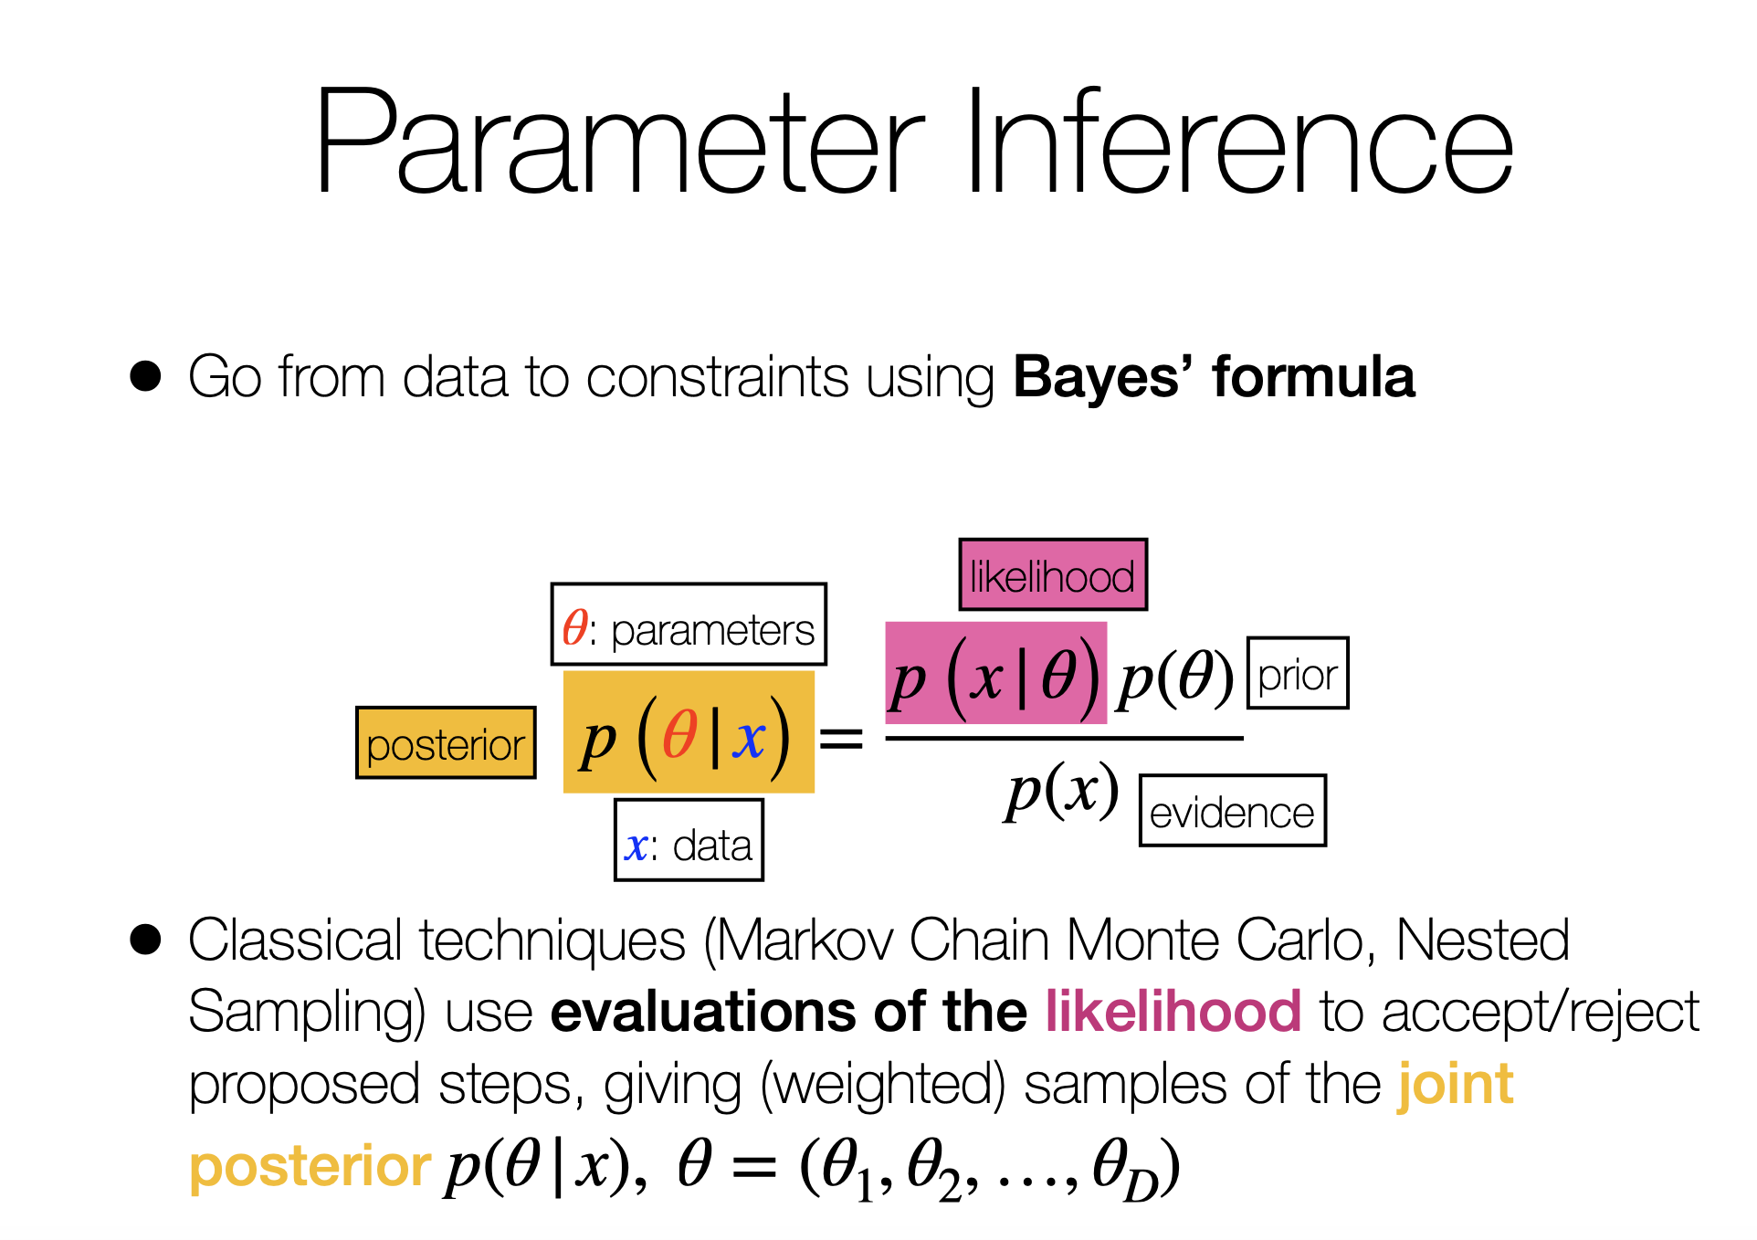

Slide 25
Final aim
Machine learning
magic

Slide 26

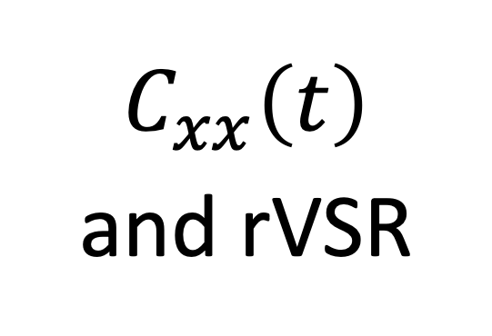
Final aim
For us $x$:
$$C_{xx}\left(t\right)$$
and rVSR
Machine learning
magic

Slide 27
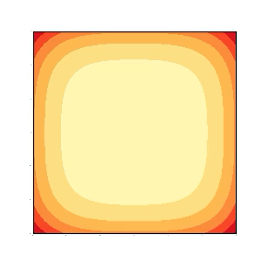
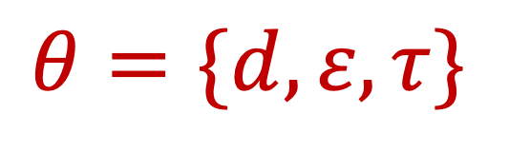
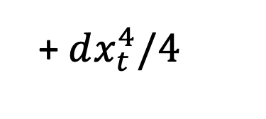

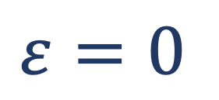
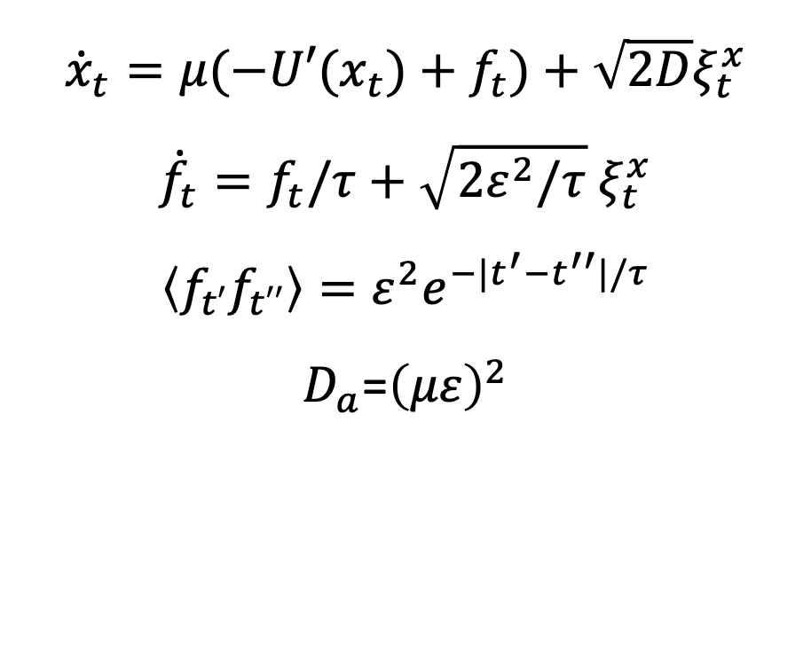
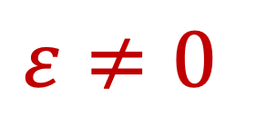
$${U(x}_{t})=κx_{t}^{2}/2$$
Example: non-linear ABM
+$dx_{t}^{4}/4$
$${\dot{x}}_{t}={μ(−U′(x}_{t})+f_{t})+\sqrt{2D}ξ_{t}^{x}$$
$${\dot{f}}_{t}=f_{t}/τ+\sqrt{2ε^{2}/τ}{ ξ}_{t}^{x}$$
$$\left\langle f_{t′}f_{t′′}\right\rangle ={ε^{2}e}^{−|t^{′}−t^{′′}|/τ}$$
$D_{a}$=${\left(με\right)}^{2}$
$$ε≠0$$
$$θ=\{d,ε,τ\}$$
Active
Non Active
$$ε=0$$

Slide 28
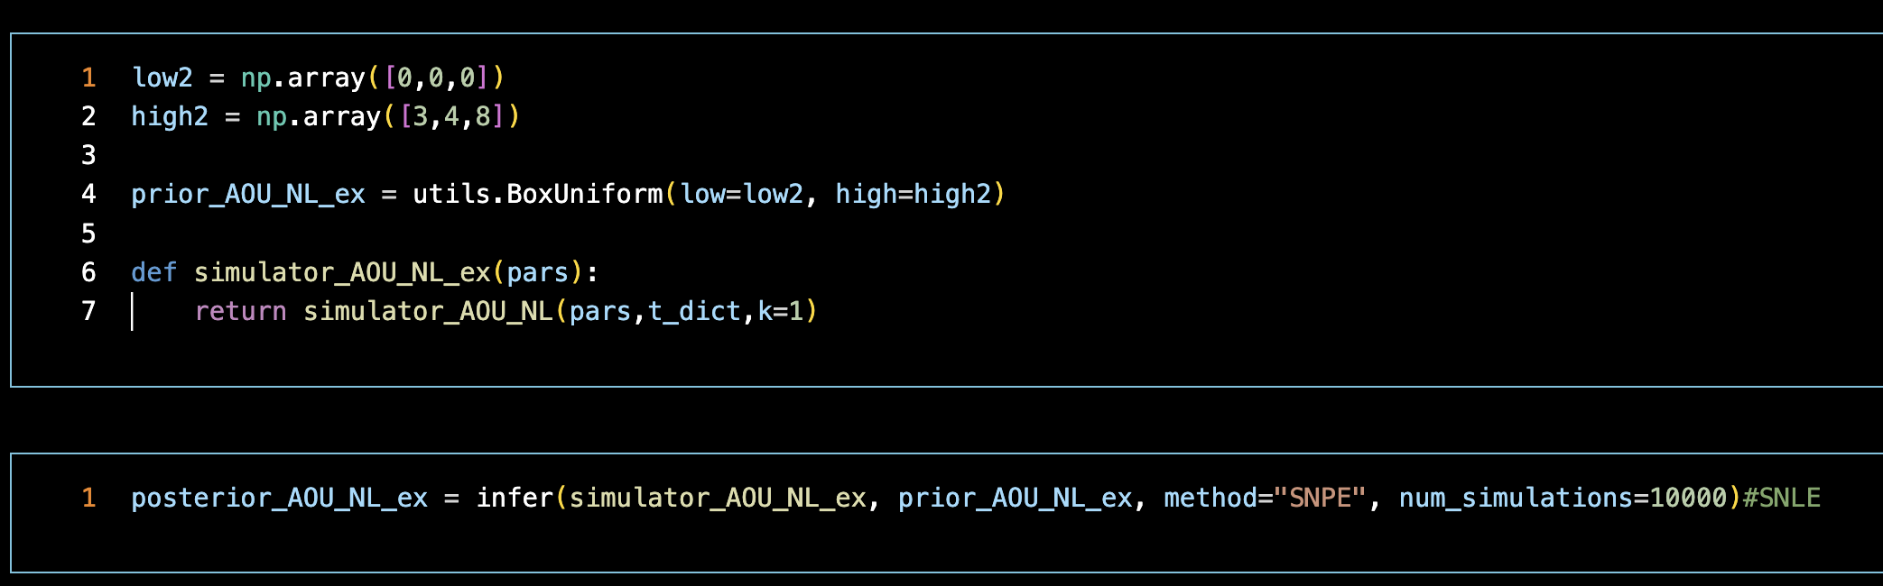


Simulator, a function that gives as
output $x$ ($C_{xx}\left(t\right)$ and rVSR)
Builds a posteriori statistics of x
given $θ$ (may take a long time)

Slide 29


Function that creates an instance for x given
a stochastic trace (X2_0)
Sample from P($θ|x$)

Slide 30
Function that creates an instance for x given
a stochastic trace (X2_0)
Sample from P($θ|x$)
Plot parameter distribution

Slide 31




$$ε$$
$$τ$$
$$d$$

Slide 32



$$ε$$
$$σ_{Est}$$
$$τ$$
$$d$$
$$σ_{True}$$

